Slide 1

Supervised Learning Part 2
Class 4
SVM, Decision Trees, and Ensemble Methods

Slide 2
Recap of Part 1

Slide 3
Support Vector Machines
The Search for the Optimal Hyperplane
Notes:
It s good in the sense that you don t need to train any parameters like it is the case for logistic regression for instance (Alpha lr for gd).
There are two instances of this algorithm one for classification (SVC) and one for regression (SVR).
They have oposite goals Svr wants to fit points inside the margin while Svc wants to keep them away and minimize the outliers in a sort of way.

Slide 4

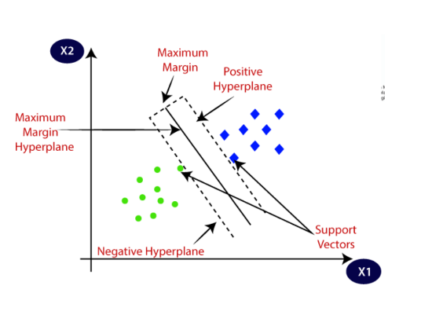
Maximum Margin Classifiers
SVMs find a hyperplane that separates classes with the largest possible margin.
Support Vectors: Data points closest to the hyperplane that define the margin.
Hard Margin: No misclassifications allowed (perfect separation).
Soft Margin: Allows some violations to handle noise and overlapping data.

Slide 5

The Kernel Trick
Mapping to Higher Dimensions
When data is not linearly separable, kernels project data into a higher-dimensional space where a linear split is possible.
3
1. Polynomial: Captures feature interactions.
Popular Kernel Types
2. RBF (Gaussian): Handles complex, non-linear boundaries.
Notes:
(ab+r)^d (Setting r=0 leaves the data always in the same direction).
e-g(a-b)^2 g is Gamma.
They are used for both svc and svr, Gaussian kernel can represent infinite dimensions (Taylor’s expansion for Maths interested people).

Slide 6
Decision & Regression Trees
Recursive Partitioning of the Feature Space
Notes:
They are non parametric models, for decision regression trees we adjust the partitions instead of Gradient descent since we have no weights to adjust.

Slide 7
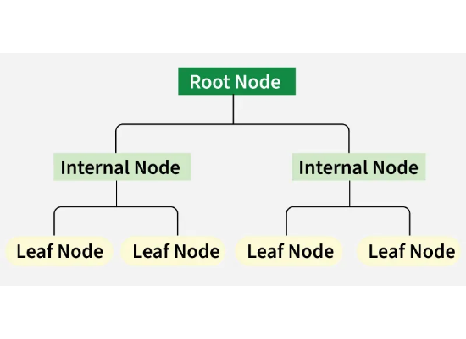
Anatomy of a Decision Tree
•
Root Node: Represents the entire population/sample.
•
Internal Nodes: Points where the data is split based on a feature test.
•
Leaf Nodes: Final predicted class or value; no further splits.
•
Recursive Splits: Dividing space into rectangular regions.

Slide 8








Impurity and Splitting Rules
Gini Index
Entropy
Classification Error
Defined as 1 minus the max probability of a class. Less sensitive to node purity than Gini or Entropy.
Measures how often a randomly chosen element would be incorrectly labeled.
Measures the uncertainty or disorder in the data distribution.

Slide 9

Regression
MSE
Standard Deviation
The tree splits where we can mostly reduce the standard deviation (square root of the variance).
$$1/n\sum{\text{(}\text{y}\text{−}\text{y}\text{_}\text{hat}\text{)2}}$$
Measures how often a randomly chosen element would be incorrectly labeled.

Slide 10

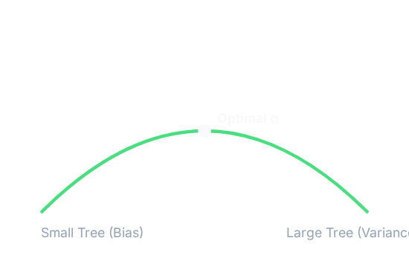

Pruning: Avoiding Overfitting
Cost-Complexity Pruning
Large trees suffer from high variance. Pruning simplifies trees to improve generalizability.
Alpha (α): The regularization parameter controlling the trade-off between fit and size.
Notes:
If we don t limit the growing of the tree it will grow to have a branch for each data point (extreme overfitting).
We can have pre-pruning by having a setted limit for the maximum depth or a minimum impurity decrease.
Post-pruning we use cost complexity pruning meaning if the error reduction is small but the number of leaves resulting is big we have to prune (high score).

Slide 11
Ensemble Methods
Combining Models for Superior Accuracy

Slide 12
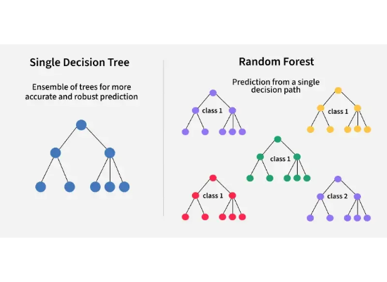
Bagging & Random Forest
Bagging: Bootstrap Aggregation. Training multiple trees on different data subsets in parallel.
Random Forest: Adds feature randomness to Bagging.
•
Only a random subset of features is considered at each split.
•
De-correlates trees, leading to massive variance reduction.
Notes:
Bootstrapping is the method by which we select each team randomly points from the original data to form a subset with replacement meaning we can have repetition of points (Trees are growing independantly).
For Bagging we take all the trees and not only select the best performing ones because if we do that may lead to the trees being all similar to each other.
For prediction we take the average of the average prediction of each tree and for classification we take the majority class voted by the trees for a given point.
Rf doesn’t randomly select data points it just randomly selects a subset of features for each tree. (No pruning).

Slide 13
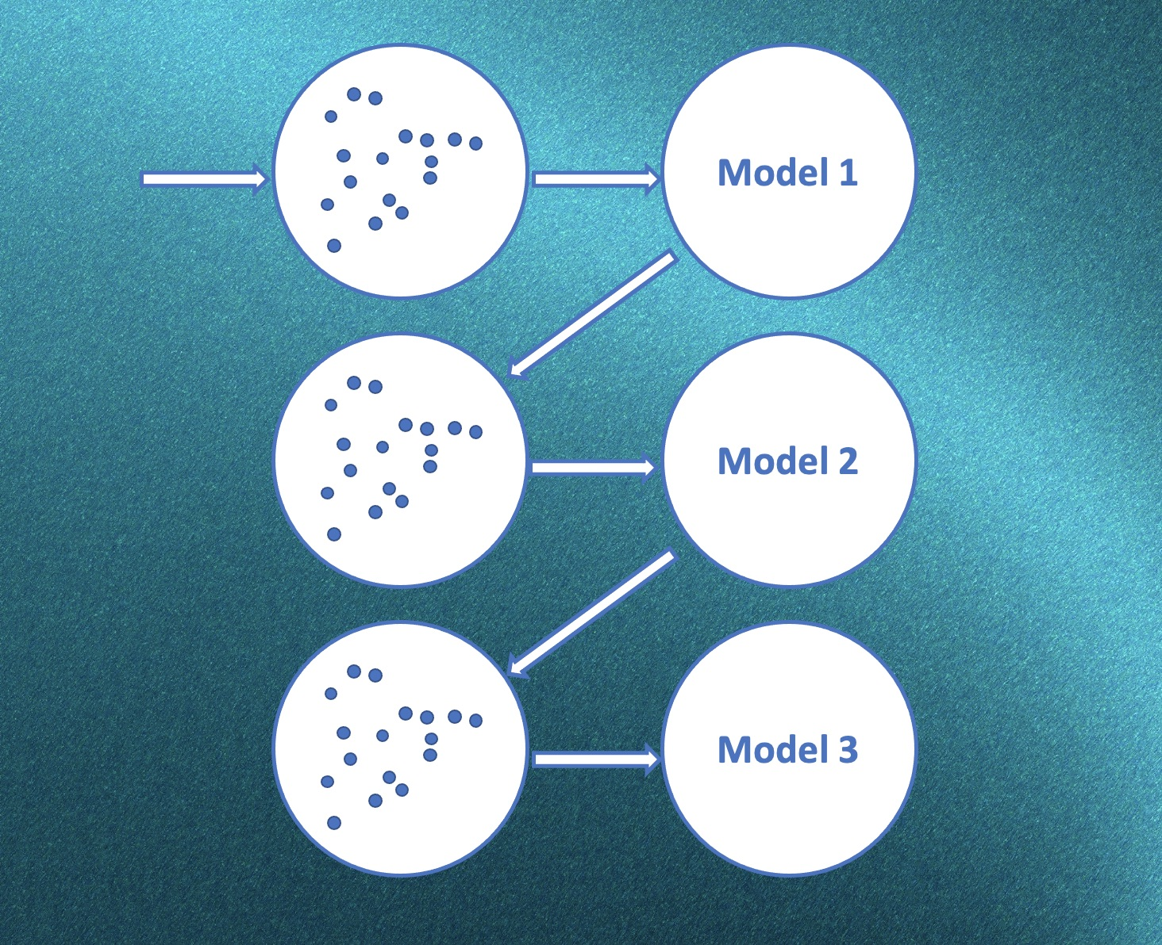
Boosting
Unlike Bagging, Boosting is sequential. Each new model attempts to correct the errors of the previous one.
Key Algorithms:
•
AdaBoost: Increases weight of misclassified points.
•
Gradient Boosting: Fits new models to the residuals of prior models.
Strongly reduces both bias and variance.
Notes:
Boosting is slower as it is done sequentially while Bagging is faster as it is done parallelaly, it is also more sensitive to outliers in comparison with Bagging.
For Boosting each new tree is just an improvement of the previous one.
Adaboost assigns sample weights for each misclassification it gives a higher weight.
Gradient Boosting is trained to fit to errors of previous trees.

Slide 14
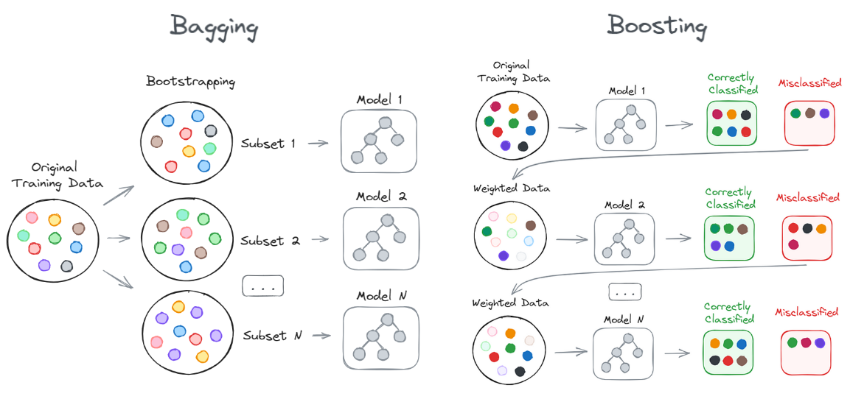

Slide 15
Stacking
Having a hierarchy of models

Slide 16
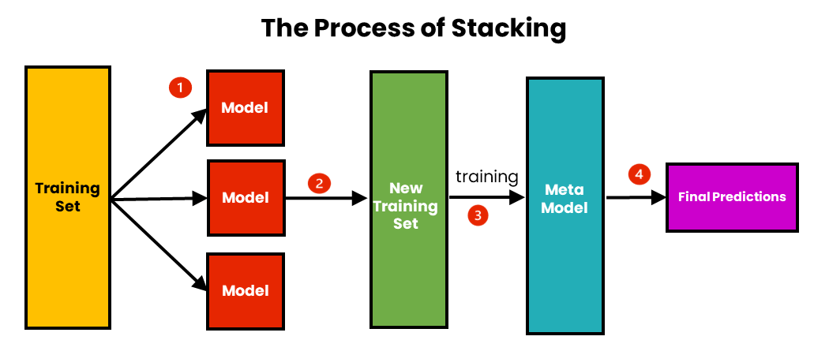
Notes:
Stacking means basically a more generalized version of ensemble methods as ensemble methods are a grouping of decision trees, stacking can have an ensemble of different algorithms such as Svm, boosting and bagging.
The goal is to have a final model after training all the models on the dataset picking which model fits best for a given task.

